Slide 1
Week 9
Linear Regression (Review)

Slide 2
Today’s Agenda
Correlation
Bivariate Linear Regression
Multivariate Linear Regression
Categorical regressors: Dummy variables
Hypothesis Testing
R-squared
P-Values
Relationship to machine learning

Slide 3
Why do we use Linear Regression?
(Doesn’t machine learning solve every prediction problem?)

Slide 4
Why do we use Linear Regression?
(Doesn’t machine learning solve every prediction problem?)
Widely used and understood
Runs quickly
Easy to use (not a lot of tuning, which we’ll learn about later, is required)
Interpretable
Basis for many other methods

Slide 5
Some stats vs machine learning language
Statistics
Machine Learning
Dependent variable (y)
Independent variables (X)
A.k.a predictor / explanatory / input / x- variables
Note:
“Covariates” are typically refer to control variables
“Treatment variables” are those whose effects you are interested in
=
=
Response or target variable (y)
Features (X)

Slide 6
Correlation
Correlation measures the strength of the linear relationship between two variables, x and y.
The closer to +1 or to -1, the stronger the correlation.
‘y’ usually represents the dependent variable and ‘x’ usually represents the independent variable(s).
You can test correlation between any variables, independent or dependent, or any combination.
Correlation can be positive or negative.
Correlation is ‘scaleless’ (unit-less) and assumes a value between –1 and 1.

Slide 7
Correlation
Both variables must be quantitative, not categorical.
Does not imply causation!
Correlation is usually written as r (Pearson’s r)
One basic rule when interpreting the correlation coefficient is to look first at a scatterplot to see if the relationship between variables is linear
If it is, you may calculate the correlation coefficient.
There are many situations where it is not sensible to calculate the correlation coefficient.

Slide 8
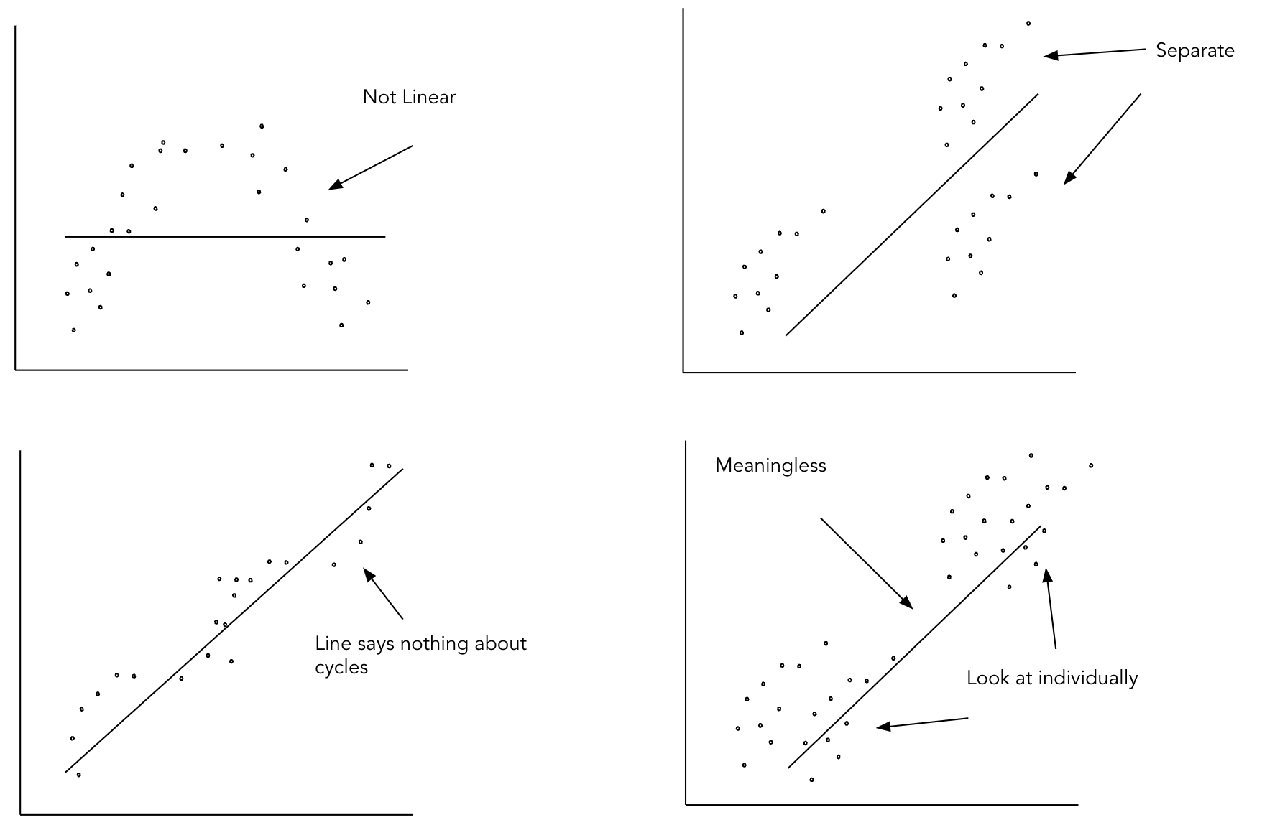
Non-Linear Examples

Slide 9
Correlation and Linear Regression
Correlation and linear regression are the most commonly used techniques for investigating the relationship between two quantitative variables.
The goal of a correlation analysis is to see whether two measurement variables co vary, and to quantify the strength of the relationship between the variables, whereas regression expresses the relationship in the form of an equation.

Slide 10
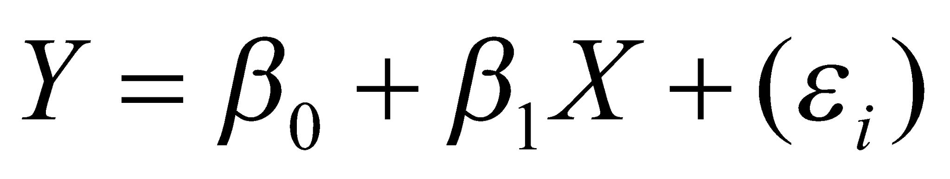
Bivariate Linear Regression
Describes a relationship between an explained variable (y) and an explanatory variable (x). You “regress y on x.”
Dependent variable is x. Independent variable is y.
Attempts to explain this relationship with a straight line fit.
Bivariate linear regression has one input (x) and one output (y)
The ideal formula to approximate the regression:
Intercept Slope Error term

Slide 11
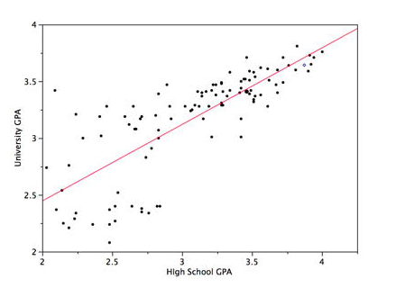
Bivariate Linear Regression

Slide 12
Linear Regression: Residuals (error terms)
Residuals (or error terms) are the difference between an observed value of the response variable and the value predicted by the regression line.
Residual = observed y – predicted y
Residuals represent the ‘leftover’ or ‘unexplained’ variation in the response variable after fitting the regression line.

Slide 13
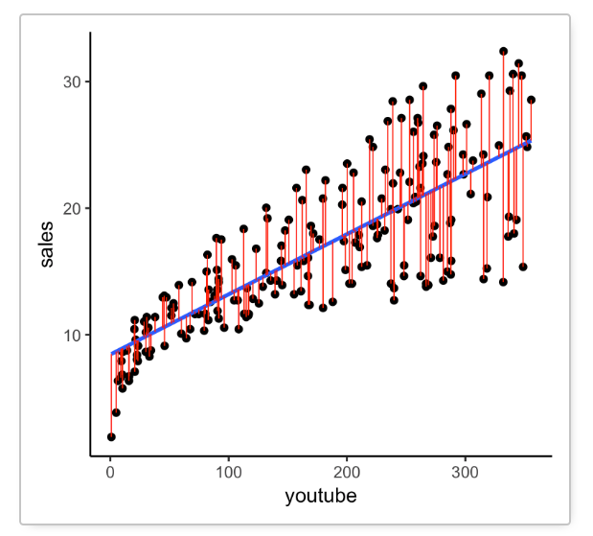
Linear Regression: Residuals (error terms)

Slide 14
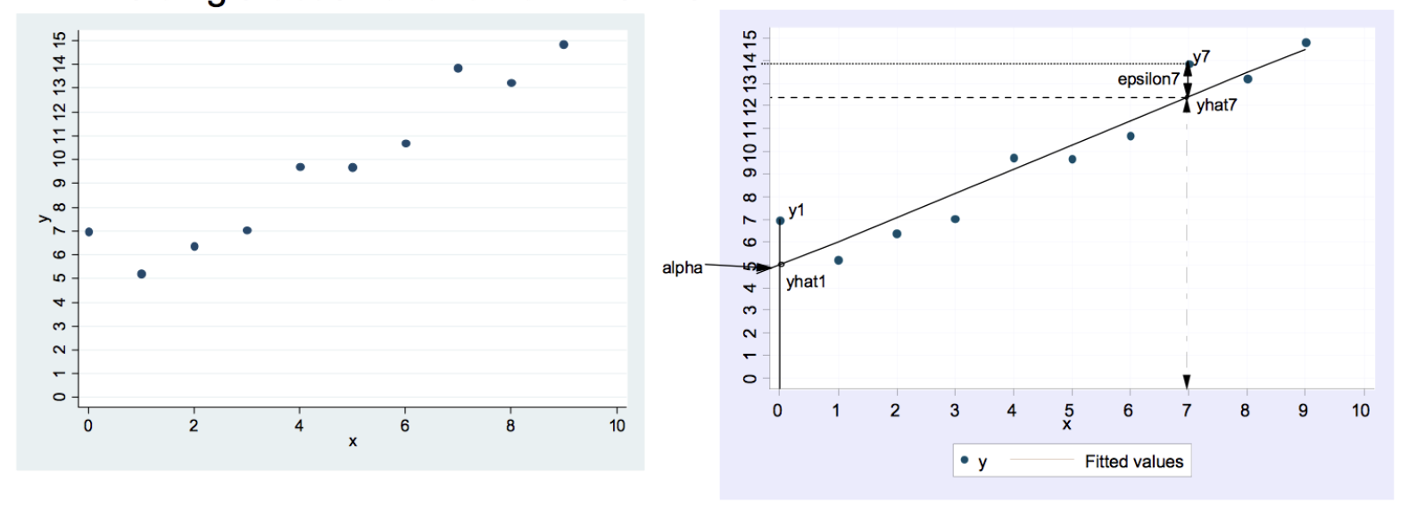
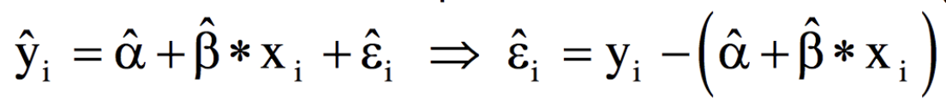
Linear Regression
In other words, draw a line through the scatterplot in a way to minimize the vertical deviations of the single observations from the line
Math: minimize the sum of all squared deviations (i.e. residuals) from the line

Slide 15
Linear Regression Assumptions
Linearity - the relationships between the predictors and the outcome variable should be linear
Normality - the errors should be normally distributed
Constant error variance (homoscedasticity); the error variance should be constant. The opposite is called heteroscedasticity.
Independence - the errors associated with one observation are not correlated with the errors of any other observation
The model is specified properly – all known variables that are relevant predictors of the dependent variable are included. There are not individual observations that exert undue influence on the coefficients.
Low multicollinearity - we avoid predictors that are highly collinear, which can cause problems when estimating regression coefficients.

Slide 16
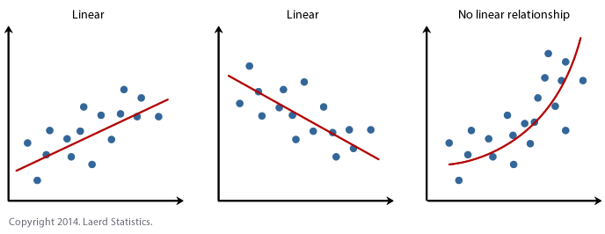
1. Linearity

Slide 17
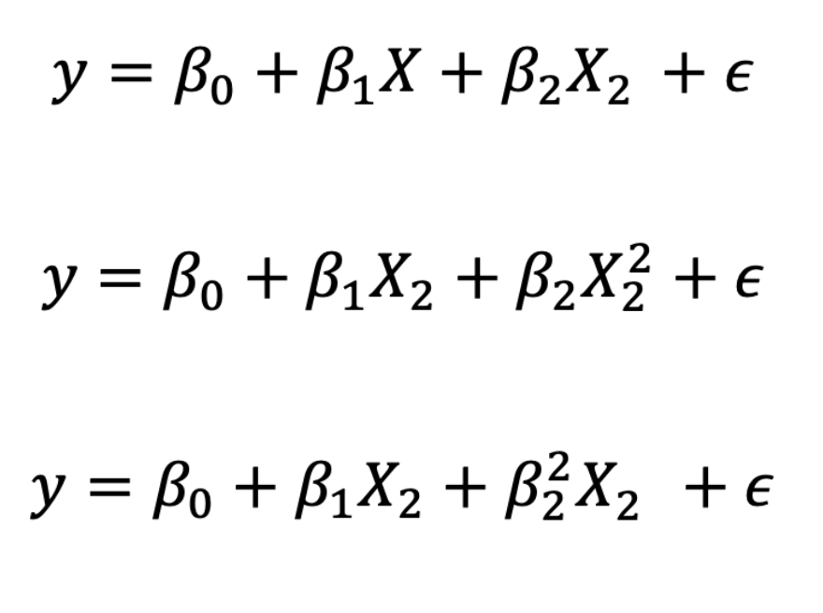
1. Linearity
Which one violates the linearity assumption?

Slide 18
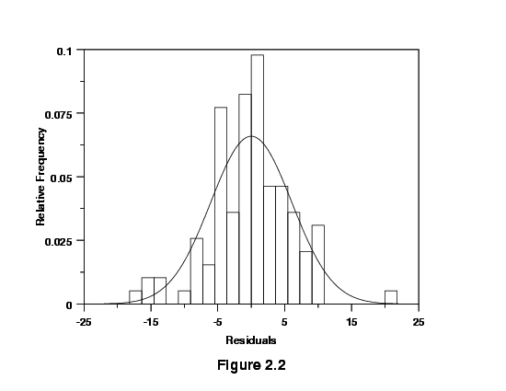
2. Normality of the Errors
Why is it important to have mean 0 normal errors?

Slide 19
2. Normality of the Errors
Why is it important to have mean 0 normal errors?
Because these are rough assumptions, I prefer graphical methods of checking

Slide 20
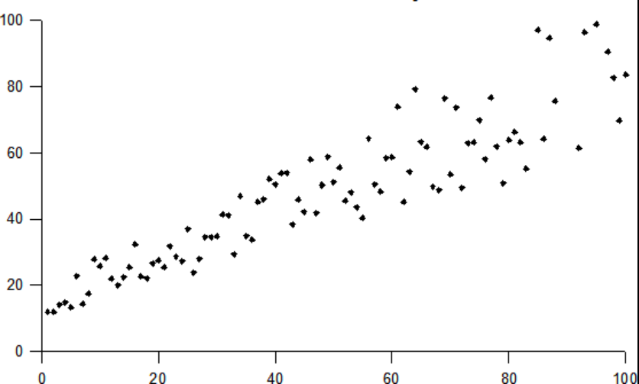
3. Homoscedasticity
Heteroscedasticity is when errors get larger as x gets larger

Slide 21
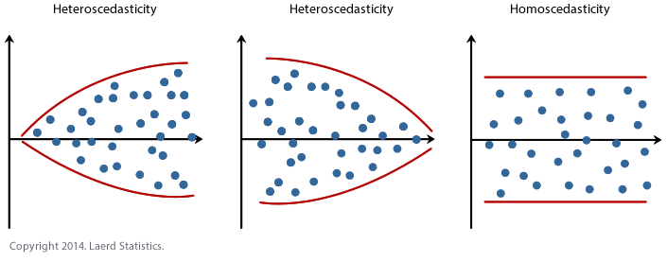
3. Homoscedasticity

Slide 22
3. Homoscedasticity
Heteroscedasticity is when errors get larger as x gets larger
Also: everything is heteroscedastic and it alone doesn’t bias your coefficient estimates (it just makes the standard errors incorrect, usually too big, which means you might fail to reject the null)

Slide 23
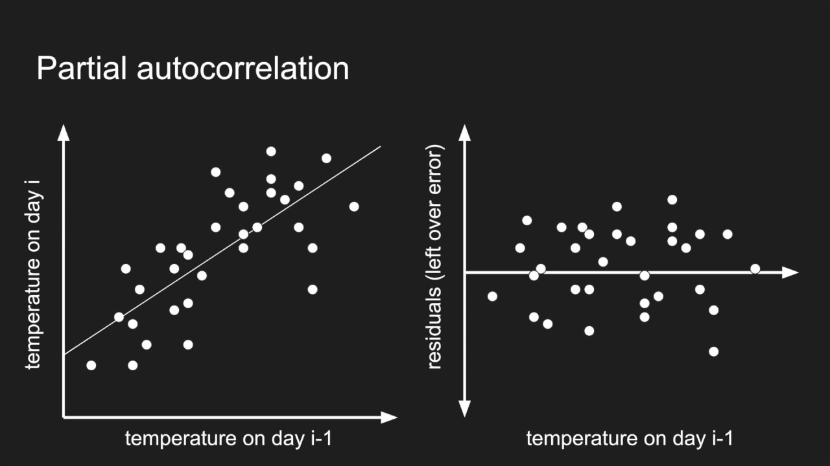
4. No Autocorrelation (i.e. independence of Errors)
Why is this bad?

Slide 24
4. No Autocorrelation (i.e. independence of Errors)
Worst case scenario: your data points are perfectly correlated…what does that mean?

Slide 25
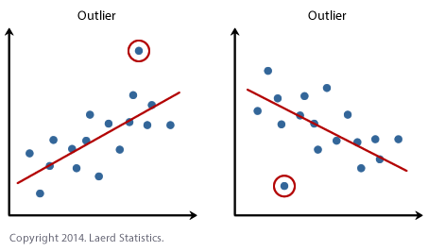
5. Outliers

Slide 26
5. Outliers
This can really skew your estimate, especially if you have smaller dataset

Slide 27
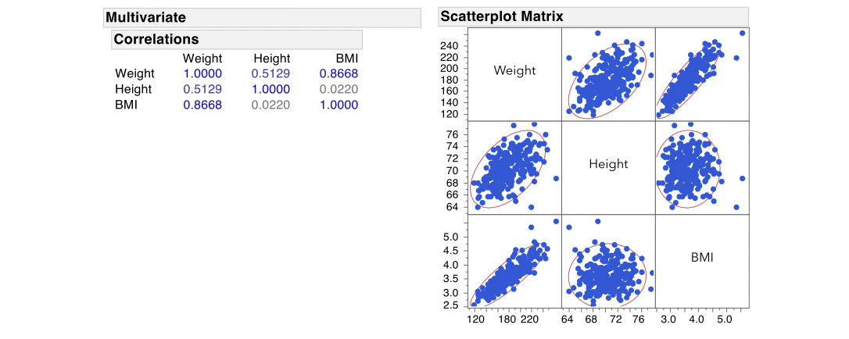
6. Multicollinearity

Slide 28
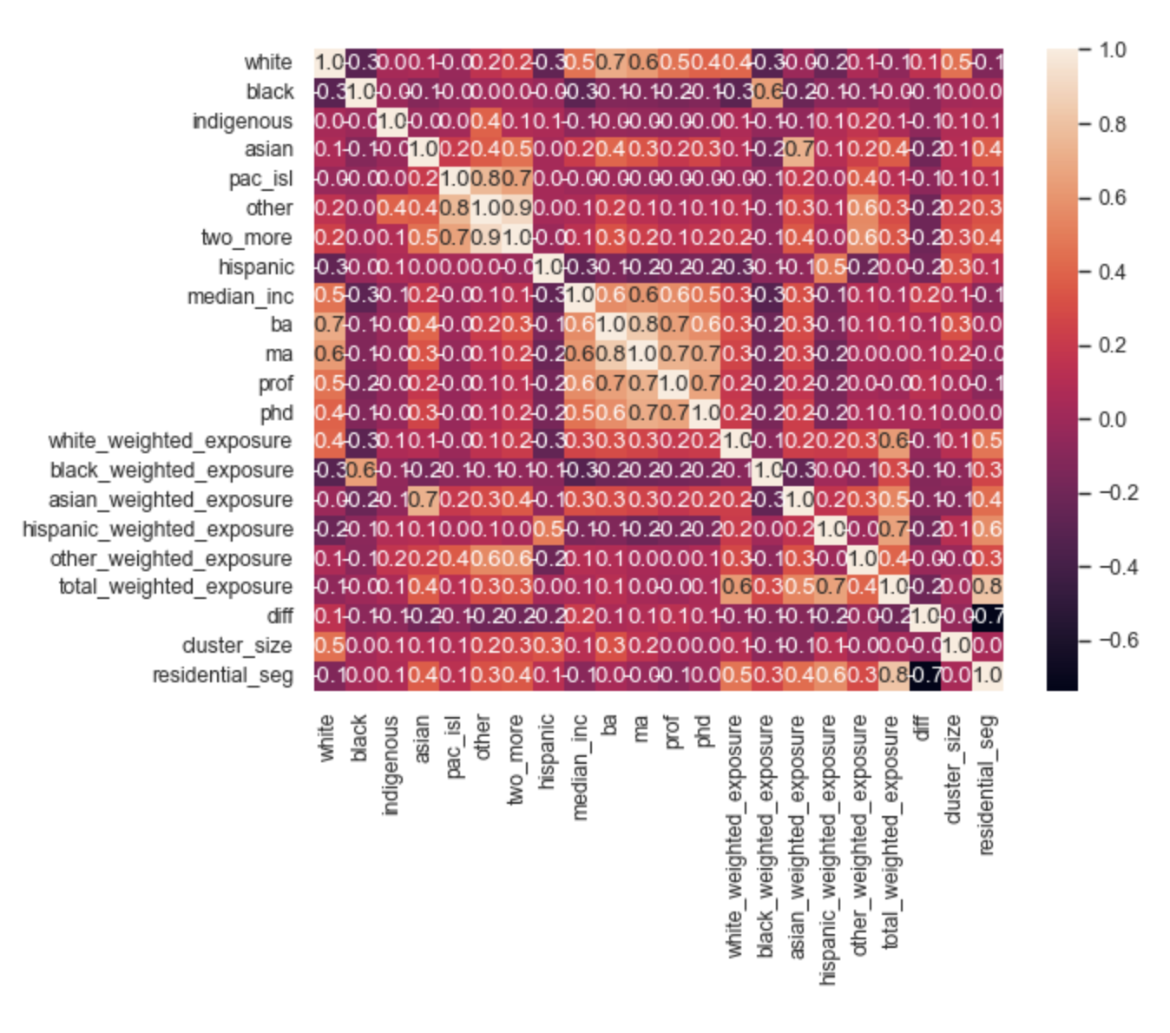
6. Multicollinearity
A correlation matrix can help both diagnose multicollinearity and rectify it.

Slide 29
Multiple Linear Regression
A dependent variable may have more than one cause.
Causal explanations are stronger when we include control variables.
When we run only a bivariate regression, we run the risk of attributing too much explanatory power to one variable. When we add more variables, sometime statistically significant relationships from bivariate models “wash out.”

Slide 30
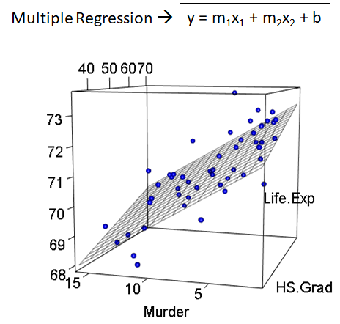
Multiple Linear Regression
Multiple regression: We are fitting again is when we try to fit a plane (if there are two covariates or regressors) through the data

Slide 31
Multiple Linear Regression
Same assumptions as bivariate, plus we must check for:
Influence - individual observations that exert undue influence on the coefficients
Collinearity - predictors that are highly collinear (linearly related) can cause problems in estimating the regression coefficients.

Slide 32
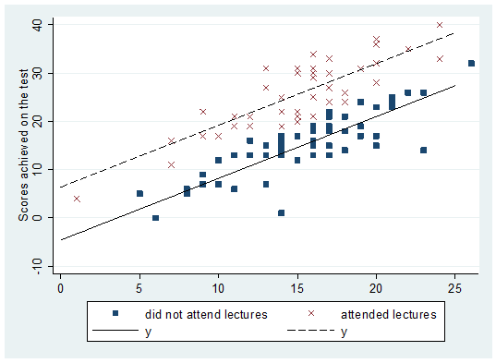
Dummy Variables
We use dummy variables if we are interested in how the dependent variable might change based on membership within certain categories

Slide 33
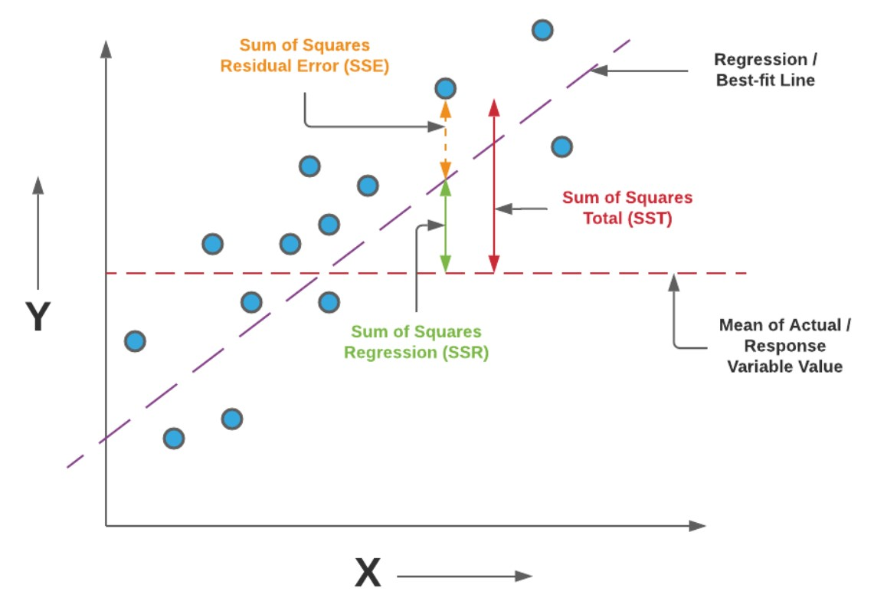
R-Squared (Coefficient of determination)
“The percentage of the total variance in the data that your model explains”
1 – SSE/SST
You will also see SSE as RSS
You will also see SST as TSS

Slide 34
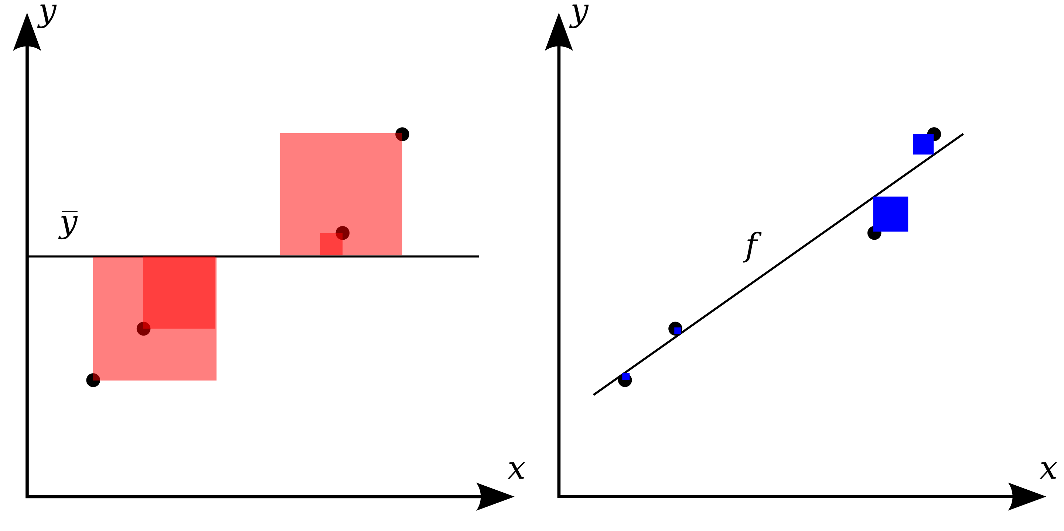
R-Squared (Coefficient of determination)
“The percentage of the total variance in the data that your model explains”
1 – SSE/SST
You will also see SSE as RSS
You will also see SST as TSS
SST
SSE

Slide 35
Hypothesis Testing
Null Hypothesis (H_{o}):
Prior belief or default belief
(usually a statement of “no effect” or “no difference”)
Alternative Hypothesis (H₁):
New way of thinking or researcher’s claim
(usually what we are interested in proving)
H_{o} and H₁ are always stated in terms of population mean behavior (μ)
H_{o} and the H₁ never overlap and are exhaustive

Slide 36
Type I and II Errors
α = alpha = Type I error
“false positives”
You rejected the Null Hypothesis when you shouldn’t have
Example: jury convicted innocent person
Used for making decisions about null hypotheses
Example: You found that the average number of cigarettes consumed this year is different from last year, when in fact average cigarette consumption did not change.
β = beta = Type II error
“false negatives”
You failed to reject the Null Hypothesis when you should have
Example: jury frees a guilty person
Difficult to compute – we will not quantify it in this course
Example: You found that the average number of cigarettes consumed this year is the same as last year, when in fact average cigarette consumption has changed.

Slide 37
P-Values
The p-value is the probability of obtaining a test statistic at least as extreme as the one that was actually observed, assuming that the null hypothesis is true
If smaller than alpha (usually 0.05) then H_{A} is true
Compare p-value to α and decide whether or not to reject the null with p-value

Slide 38
P-Values
P-value < α then
reject H₀
P-value ≥ α then fail to reject H₀
reserve judgment on H₀

Slide 39
My Gripe about P-Values
The p-value is only a measure of surprise, not
How important the statistic is
How right you are
How large the effect size is (that’s in your test statistic)
Statistical significance does not result in practical significance
Does a p-value of 0.06 vs 0.05 (the standard threshold) really mean our statistic is not important? Really??

Slide 40
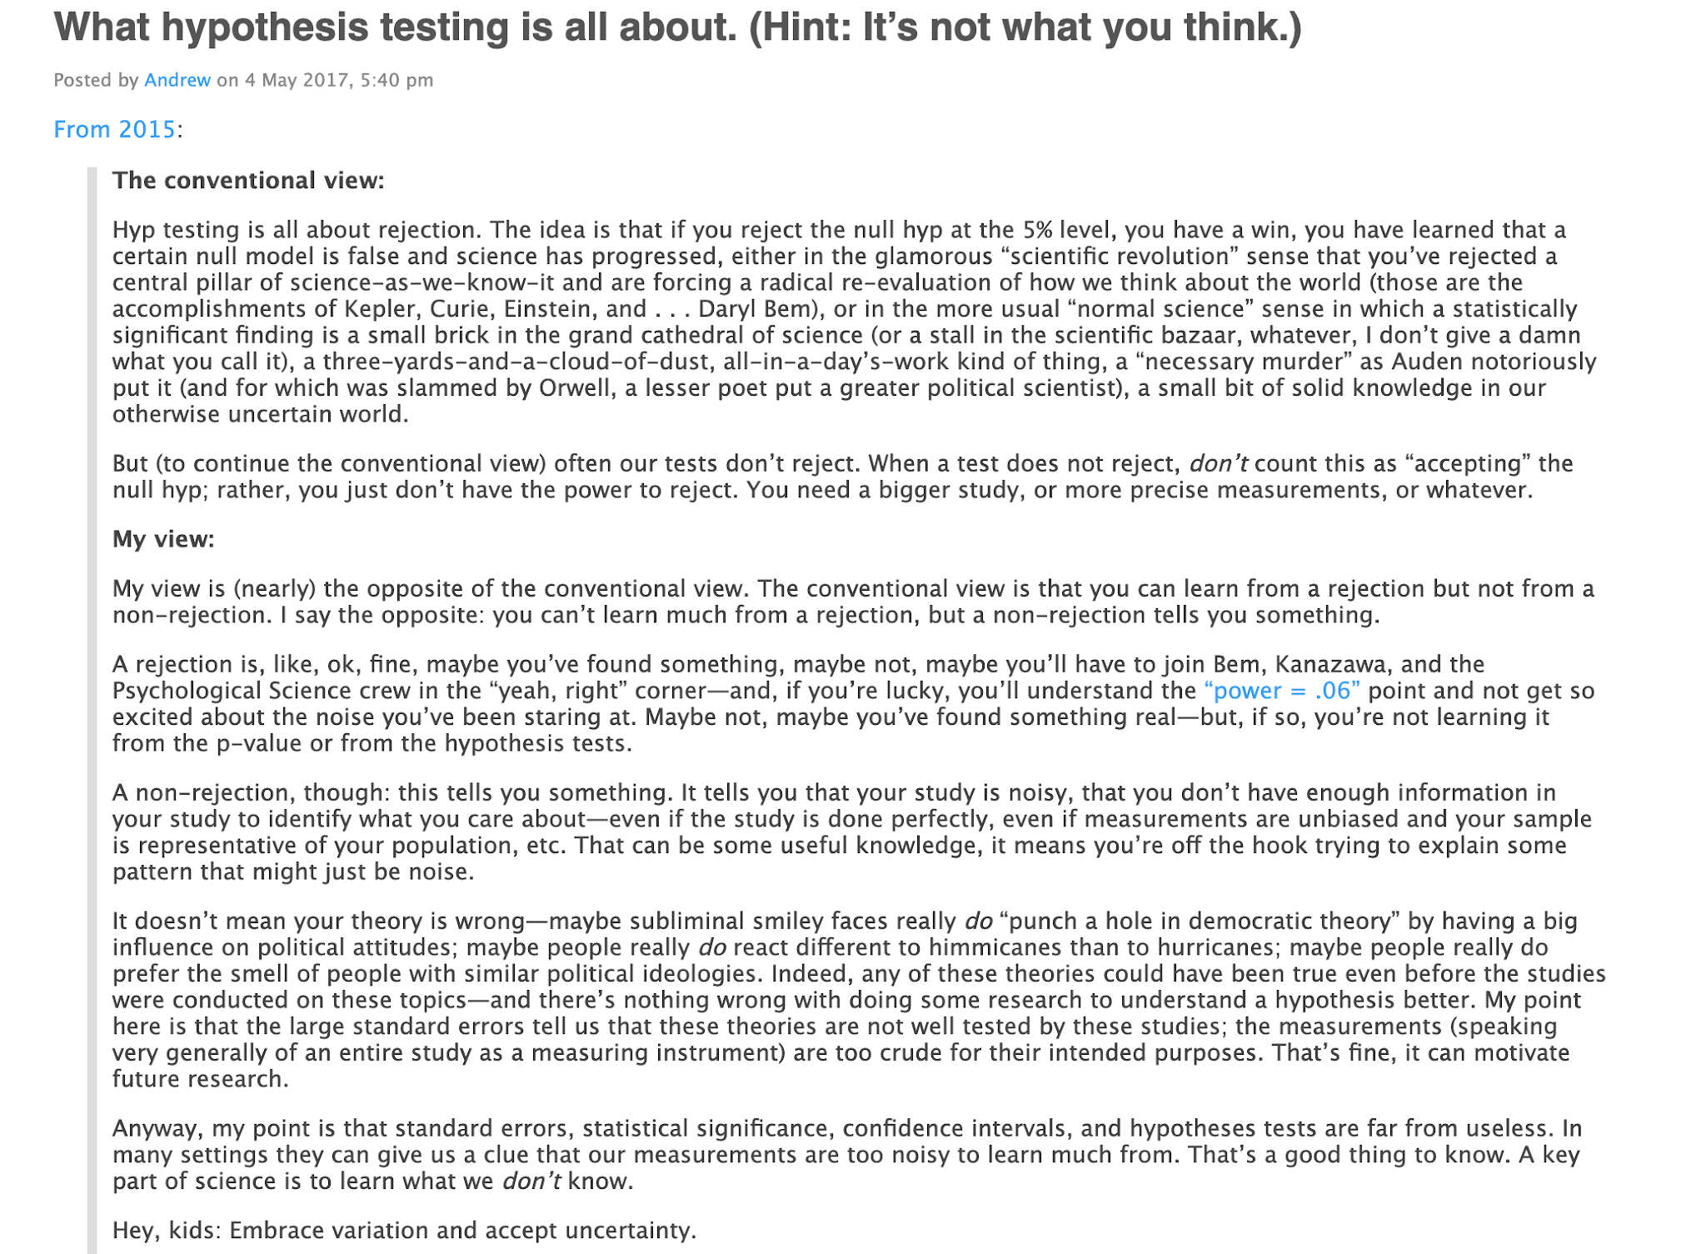

Slide 41
In other words, the world is not a binary one where we either “reject” or ”accept” based on some arbitrary criteria.
A non-rejection could likely mean your data is too noisy to see patterns. That’s useful information!

Slide 42
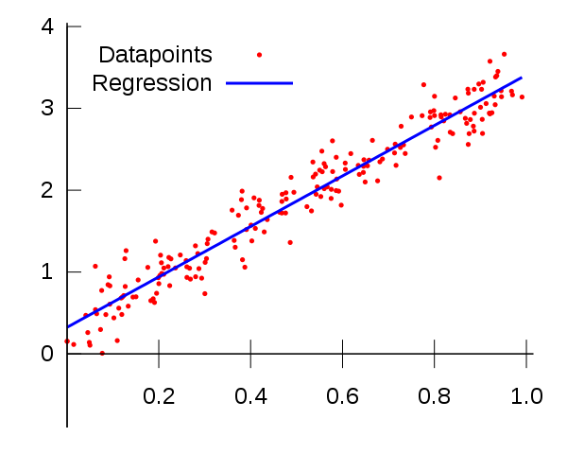
Linear Regression -> Linear Models in ML
Linear regression is similar concept to a category of machine learning models called “linear models”
Linear models assume that data can be separated linearly (i.e. by a line in 2D, a plane in 3D, etc)

Slide 43
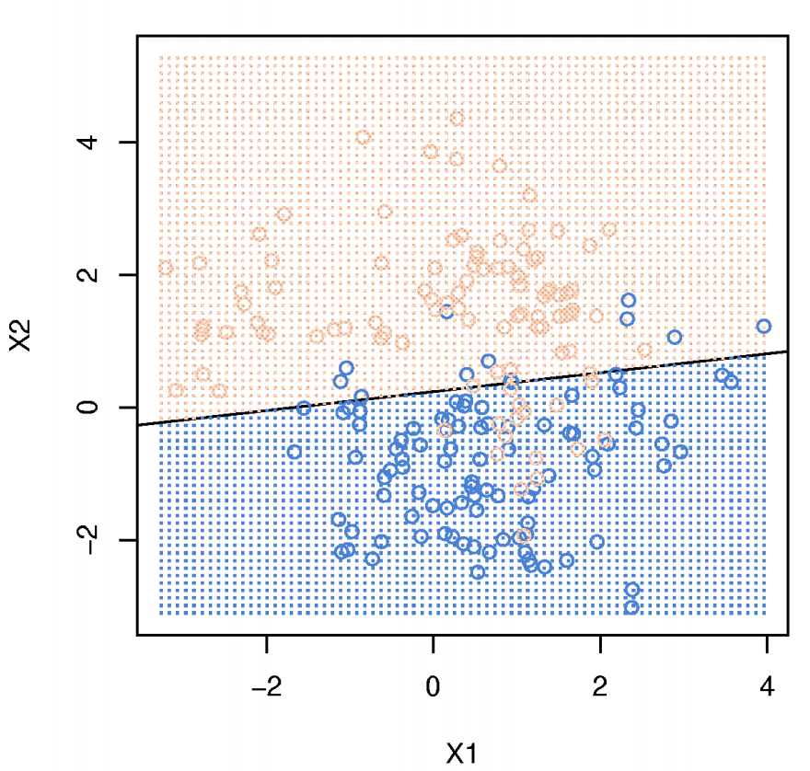
Linear Regression -> Linear Models in ML
We can also use linear modeling for classification

Slide 44
Types of Linear Models
Ordinary Least Squares
Polynomial regression
Perceptron
Stochastic Gradient Descent
etc

Slide 45
Types of Linear Models
Similar to linear regression: We are always trying to minimize prediction error based on some objective

Slide 46
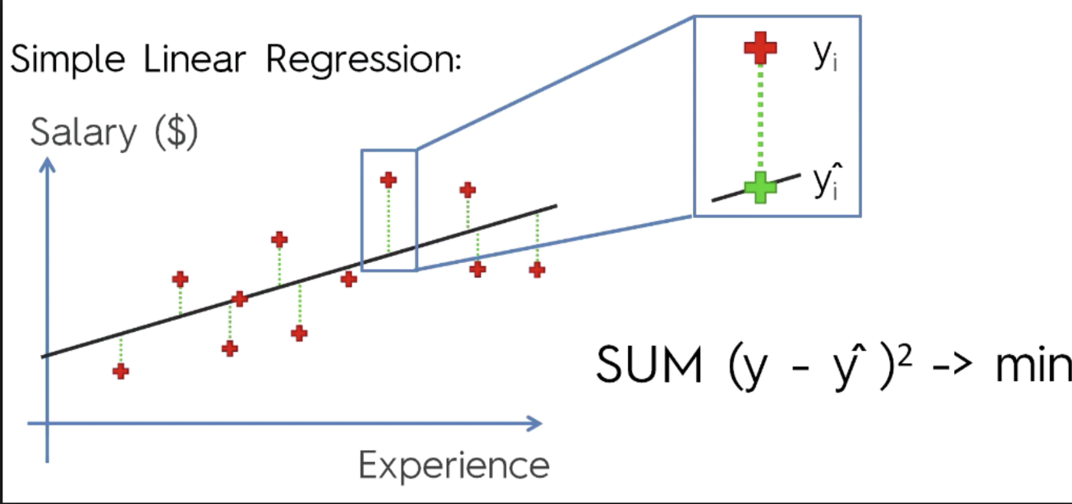
Types of Linear Models
Ordinary Least Squares
Polynomial regression
Perceptron
Stochastic Gradient Descent
etc

Slide 47
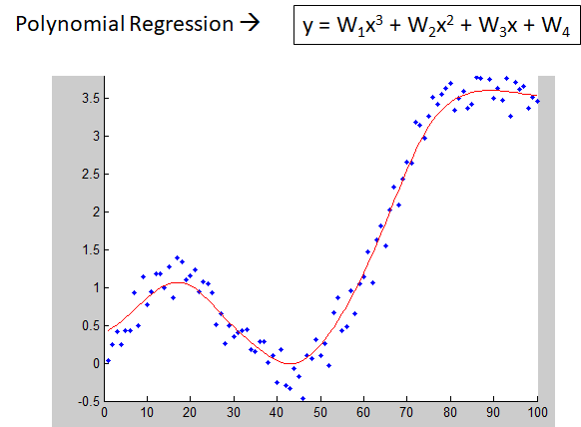
Types of Linear Models
Ordinary Least Squares
Polynomial regression
Perceptron
Stochastic Gradient Descent
etc

Slide 48
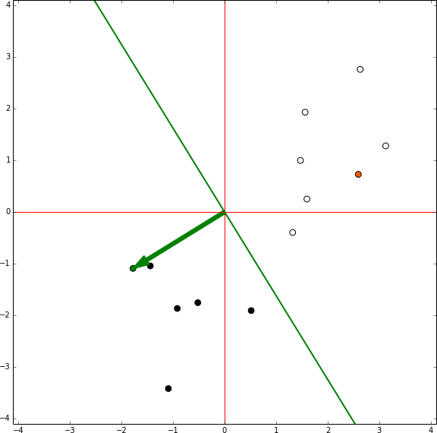
Types of Linear Models
Ordinary Least Squares
Polynomial regression
Perceptron
Stochastic Gradient Descent
etc

Slide 49
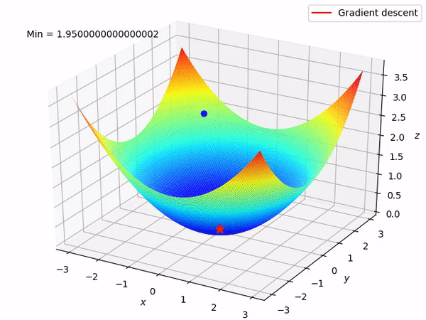
Types of Linear Models
Ordinary Least Squares
Polynomial regression
Perceptron
Stochastic Gradient Descent
etc
Notes:
In this same way that our linear regression algorithms are trying to find the slopes of lines minimize the sum squared residuals, we are trying using some objective function and randomly guesses based on a sample of the data of which linear combinations of our features can minimize the sum squared residuals.

